Slide 1

Materials Science
An introduction to materials science
ATAR Chemistry Unit 1, 2021

Slide 2
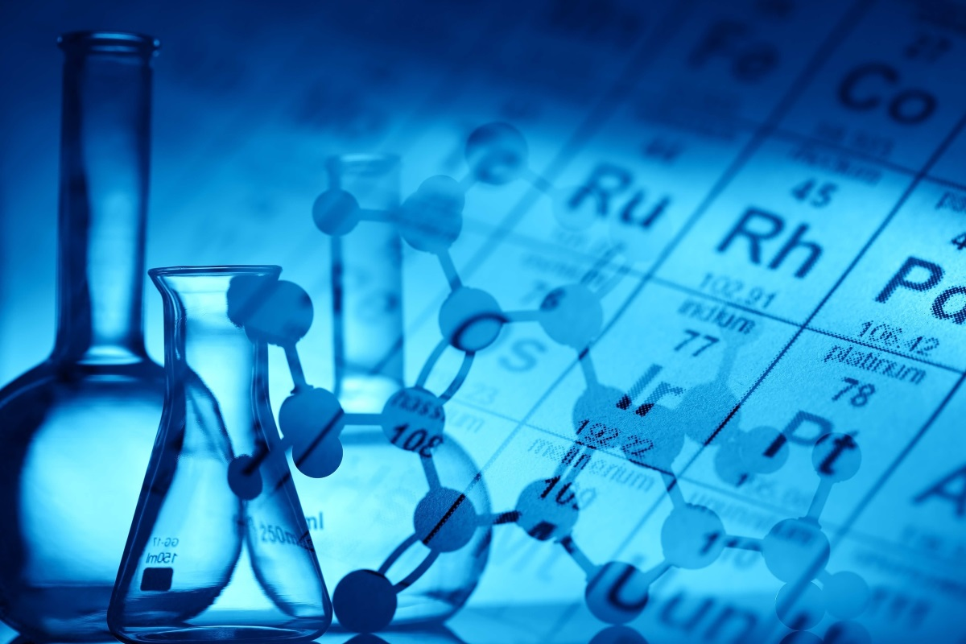
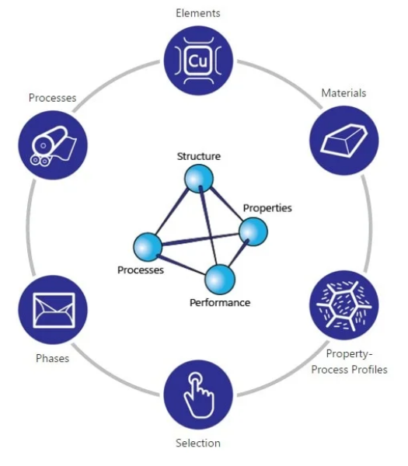
Outline
Outline:
  Materials science introduction
  Materials
      Pure substances
      Mixtures
    Metals
    Polymers
    Ceramics
    Composites
Resources:
  Pearson 11 chapter 1.1

Slide 3
Materials science
Materials science: the basic knowledge about the relationships between internal structure and properties including processing of materials
https://www.youtube.com/watch?v=py5tPlOaJVY
Materials science is interdisciplinary, you need chemistry, physics, engineering and mathematics to work in this field.
From the chemical perspective the focus is on structure and properties of the materials and how are they are related and can be exploited.

Slide 4
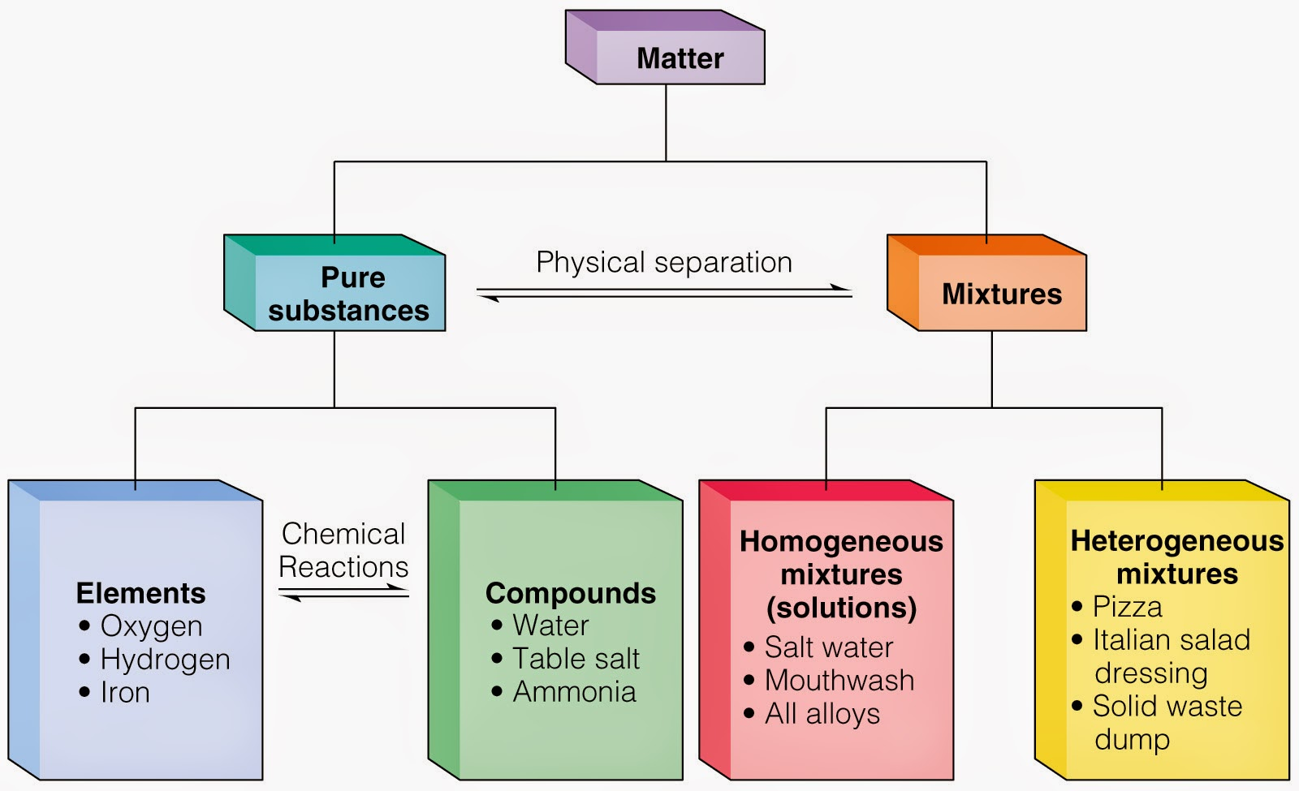
Materials
Materials – usually describes substances that are used to make objects. For example, wood, metals, ceramics, plastics, glass and fibres.
Materials can be pure substances or mixtures

Slide 5
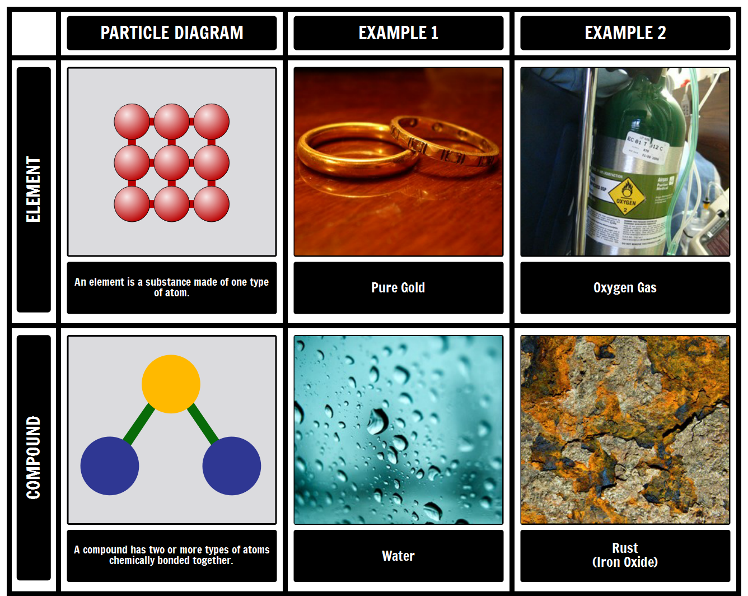
Pure substances
Pure substances are made up of only one type of particle
They cannot be physically separated into other substances
Pure substances have fixed physical properties, such as melting and boiling point, reactivity, hardness and density, conductivity.
Two categories of pure substances:
        Elements
        Compounds

Slide 6
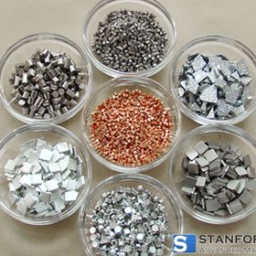
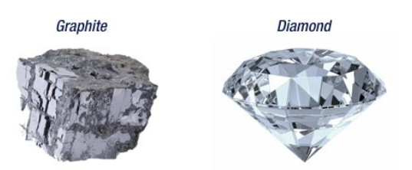
Pure substances
Elements:
  substances made up of just one type of atom (ie atoms with the same atomic number)
  Examples – pure metals such as gold, silver, tin, nickel. Carbon is an example of a non-metallic element that forms a variety of materials (eg diamond, graphite, nanotubes)

Slide 7
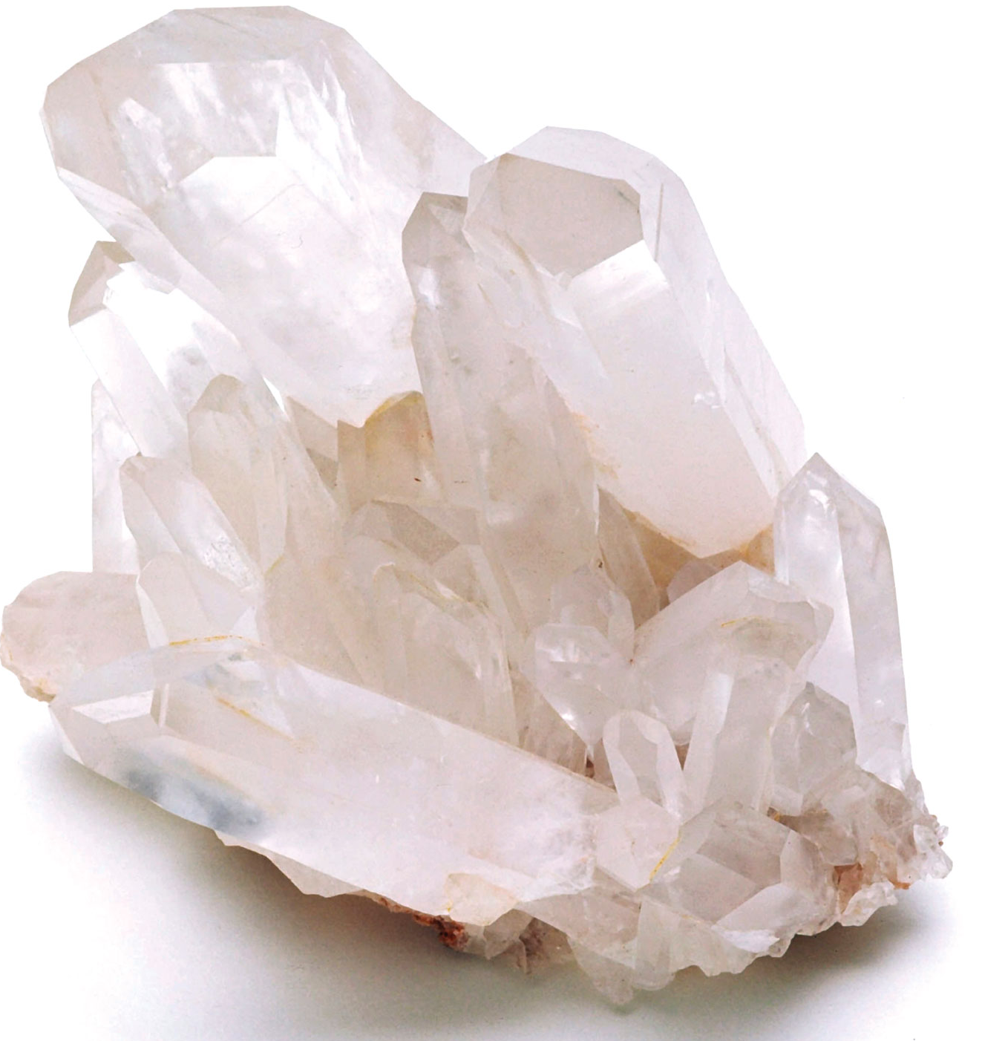

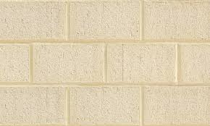

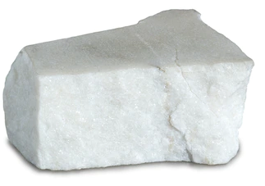
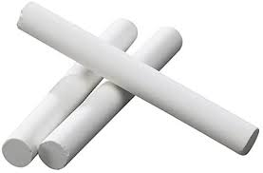
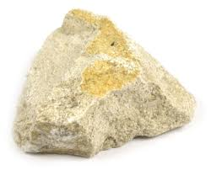
Pure substances
Compounds:
  Pure substances made up of more than one type of atom.
  They consist of more than one element in fixed proportions, for example water only contains hydrogen and oxygen atoms in the fixed proportion of 2:1 (H₂O)
  the formula of a compound indicated the relative number of each element in the compound.
Silica, SiO₂
Calcium carbonate, CaCO₃

Slide 8
Mixtures
Two or more pure substances can combine to form a mixture therefore mixtures are made up of more than one type of particle.
The formation of a mixture does not result in a new substance.
A mixture is just a physical combination of pure substances and as such mixtures can be physically separated into their components.
Mixtures have variable physical properties, depending on their components.
Have homogeneous mixtures or heterogeneous mixtures

Slide 9
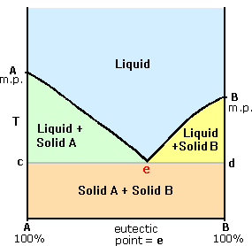
Mixtures
Mixtures have variable physical properties, depending on their components.
What are we looking at?
  X-axis is temperature and Y-axis is the percentage composition of A and B in the mixture
  Pick a temperature
  At this temperature we could have
    Pure A – solid
    Pure B – solid
    50/50 A/B – liquid

Slide 10
Mixtures
Mixtures can be divided into two types based on their composition. These are homogeneous mixtures and heterogeneous mixtures.
Homogeneous Mixtures
Homogeneous mixtures have uniform composition
This means that regardless of where a sample is taken from, the sample would contain the same blend of components.
Examples of homogeneous mixtures include solutions such as mouthwash, stainless steel, sea water
Heterogeneous Mixtures
Heterogeneous mixtures have non-uniform composition
This means that if samples were taken from different places within the mixture, the blend of components would not be the same.
Examples of heterogeneous mixtures include suspension and colloids such as mud and a bowl of cereal with milk.

Slide 11
Materials
Materials can be pure substances or mixtures. The substance or mixture of substances are carefully selected so that the physical properties match the intended use.
Many of the materials you will see all around you fall into three classifications:
      Metals
      Polymers
      Ceramics

Slide 12
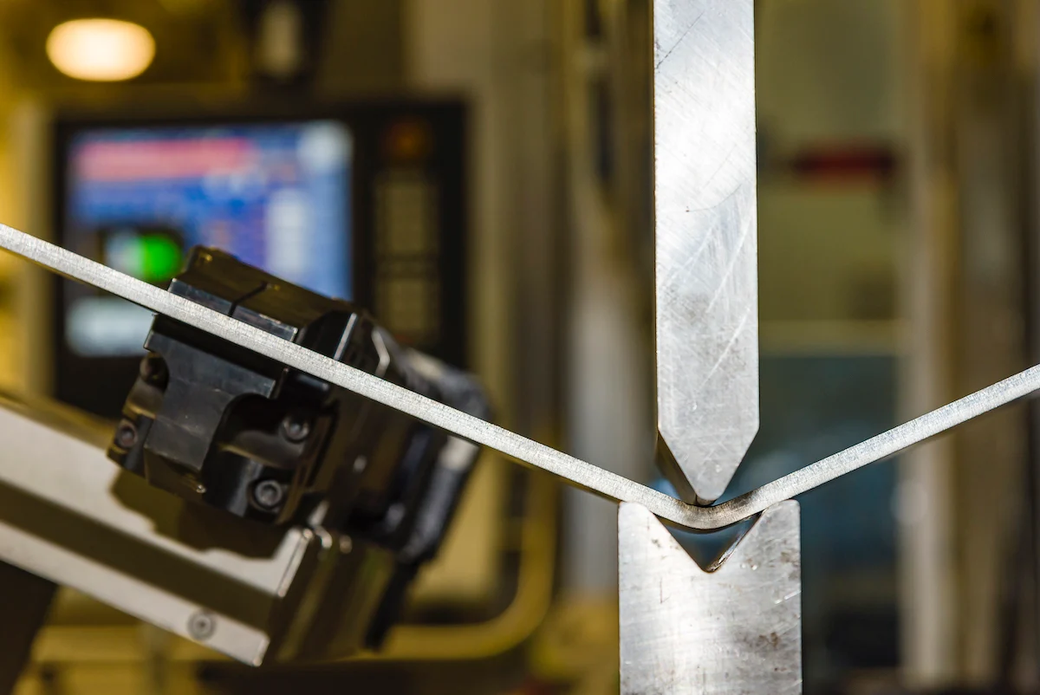
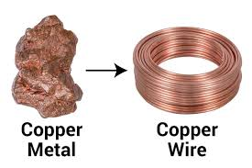
Metals
Metals account for 80 % of all known elements
Only a few metals exist in their elemental metallic state, these include gold and copper. The remainder exist as minerals in ore (e.g. iron from haematite – Fe₂O₃)
Useful properties of metals – high tensile strength, ductility, malleability, shiny lustre, high melting points, and thermal and electrical conductivity

Slide 13
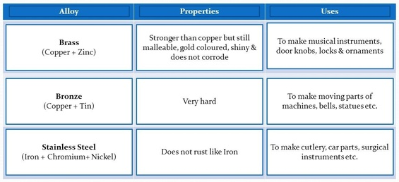
Metals
Alloys – an alloy is a mixture, alloys help to refine the physical properties of the material

Slide 14
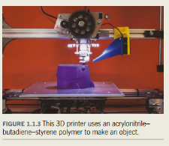
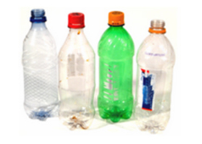
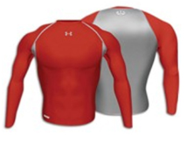

Polymers
A material with a molecular structure that is composed of many repeating smaller units bonded together (you explore polymers in detail in Year 12 Chemistry)
Polymeric materials include plastics (e.g. polyethylene, nylon) and rubbers (e.g. latex)
Useful properties of polymers – low density, corrosion resistant, electrical insulators, biological polymers, such as cellulose, have good compatibility with human tissue.

Slide 15
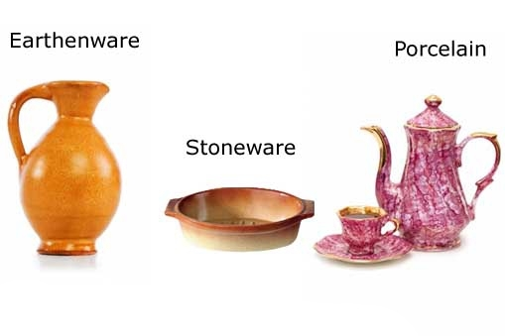
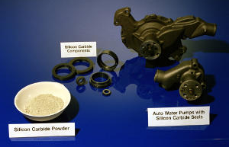
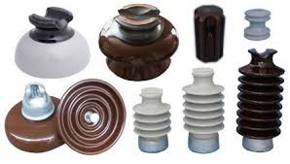
Ceramics
Ceramics are inorganic, non-metallic solids. They contain metal, non-metal and metalloid elements held together by ionic and covalent bonds
Ceramics can range from highly order (crystalline) to highly irregular (amorphous). Some are natural occurring e.g kaolinite (used to make porcelain) and some synthetic e.g. silicon carbide (an abrasive)
Due to the wide range of elements and bonding the properties of ceramics vary greatly. They are generally hard, have high compressive strength and can withstand high temperatures.

Slide 16
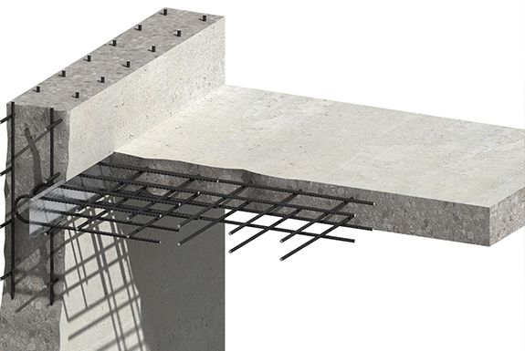
Composite materials
A composite material is a combination of two or more distinct materials with significantly different physical and chemical properties.
The resulting material contains a range of properties
Example – Reinforced concrete, this consists of steel bars embedded in concrete. The low tensile strength of the concrete (a ceramic) is countered by the high tensile strength of the steel (a metal alloy) while still maintaining the high compressive strength of concrete.

